Slide 1
16-BIT SUBTRACTION
EXP NO: 6
AIM: To write an assembly language program to implement 16-bit subtraction using 8085 processor.
ALGORITHM:
1) Start the program by loading a register pair with address of 1st number. 2) Copy the data to another register pair. 3) Load the second number to first register pair. 4) Subtract the two register pair contents. 5) Check for borrow. 6) Store the value of difference and borrow in memory locations. 7) End.
PROGRAM:
LHLD 2050 XCHG LHLD 2052 MVI C,00 MOV A, E SUB L STA 2054 MOV A, D SUB H STA 2055 HLT

Slide 2
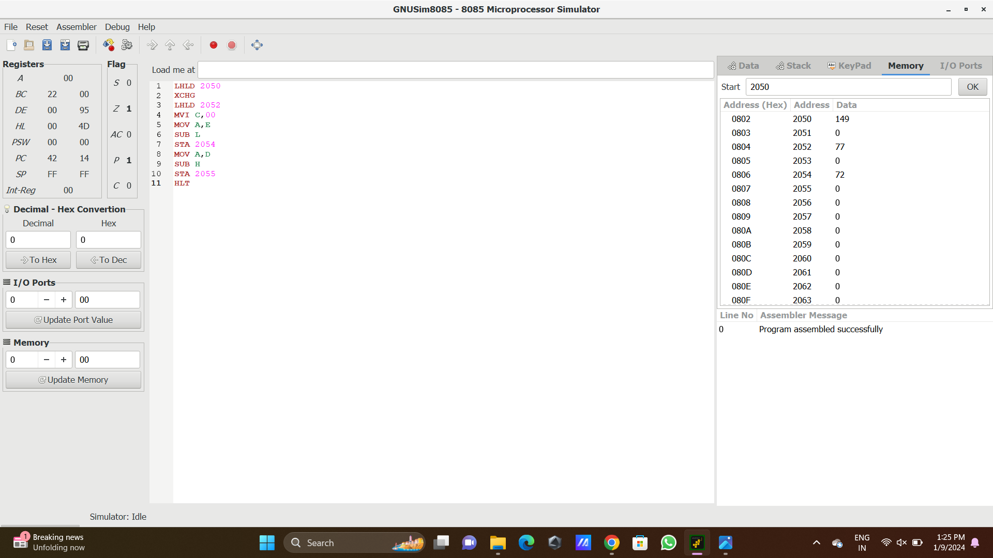
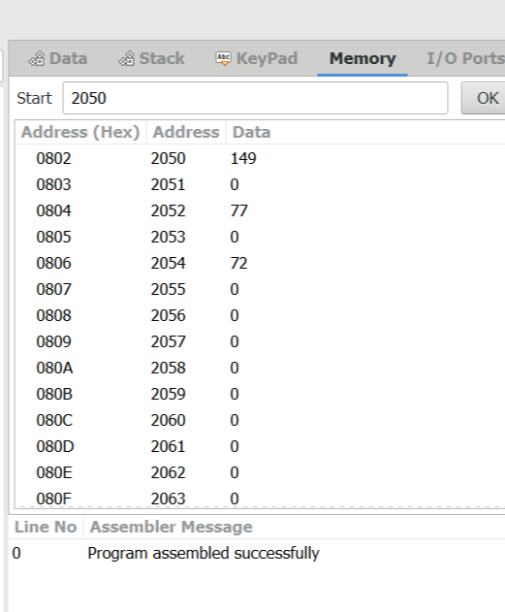
Input
output

Slide 3
RESULT: Thus the program was executed successfully using 8085 processor simulator.

